Slide 1
What is ebola, and how will it affect us?
By: Elaine thai

Slide 2
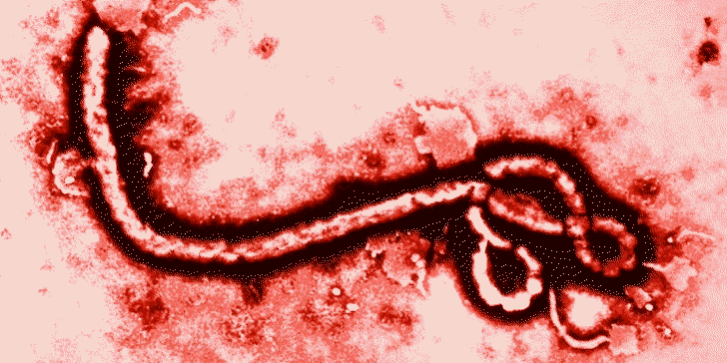
Ebola: What is it?
“Ebola virus disease (EVD), formerly known as Ebola haemorrhagic fever, is a severe, often fatal illness in humans. “ – WHO
It is a deadly virus; however it is not easily reproducible and transmissible as viruses such as the flu.

Slide 3
Ebola: Mortality rate
“Filoviruses are zoonotic and among the deadliest viruses known to mankind, with mortality rates in outbreaks reaching up to 90%. Despite numerous efforts to identify the host reservoir(s), the transmission cycle of filoviruses between the animal host(s) and humans remains unclear.” - http://www.ncbi.nlm.nih.gov/pmc/articles/PMC3378103/
50% is the average fatality rate, with some cases varying from 25% to 90% in past outbreaks.

Slide 4
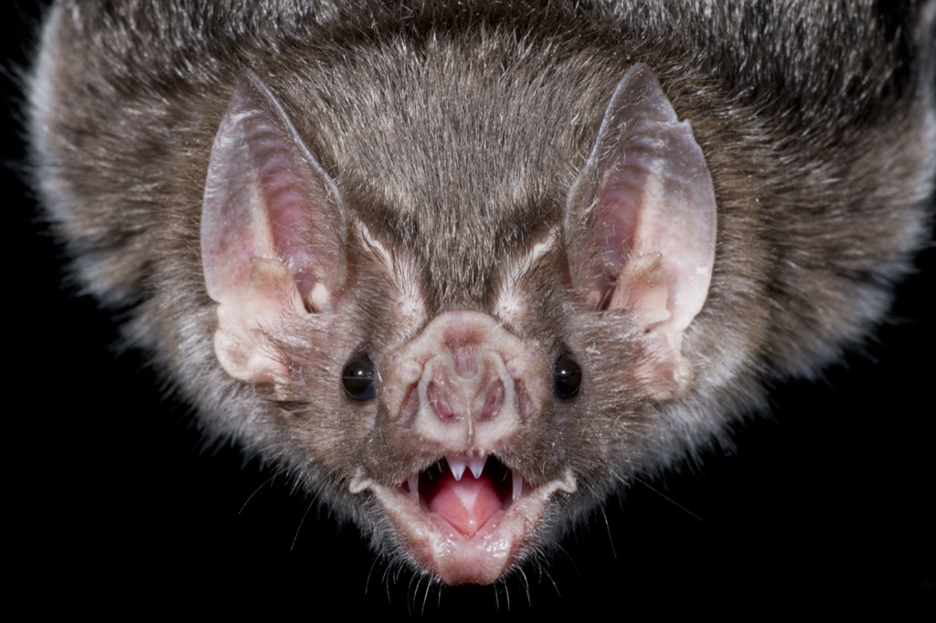
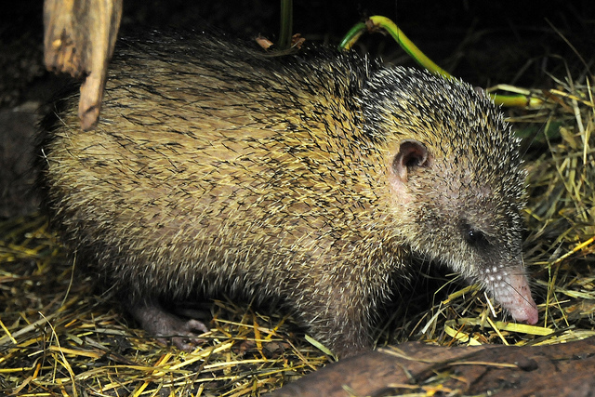
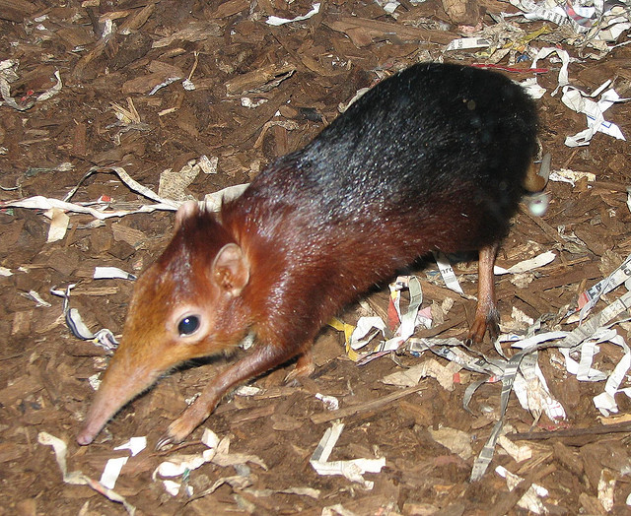
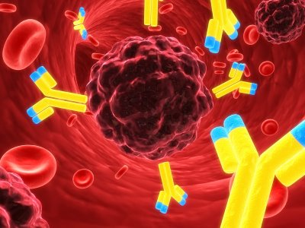
Ebola: Origins
Bats, rodents, shrews, tenrecs and marsupials were found to carry filovirus-like elements in their genomes. Filoviruses are at minimum 10,000,000 years old.
“The ongoing threat of emerging hemorrhagic diseases has made the search for reservoir species with a history of coevolution with filoviruses a priority… Bats are considered a candidate for a reservoir based on the detection of filovirus-specific RNA, antibodies, and viral particles.”
- http://www.biomedcentral.com/1471-2148/10/193

Slide 5
Ebola: How it spreads
Ebola is introduced into the human population through close contact with bodily fluids of infected animals.
Ebola then spreads through human-to-human transmission by direct contact with bodily fluids of infected people, or with contaminated surfaces and materials of these fluids or secretions.

Slide 6
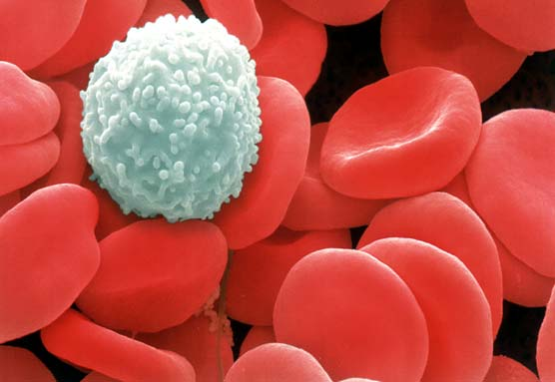
Ebola: Symptoms
There is an incubation period in which symptoms may appear within 2 to 21 days.
“Humans are not infectious until they develop symptoms” – WHO
Beginning symptoms: fever fatigue, muscle pain, headache and sore throat.
Advanced symptoms: Vomiting, diarrhea, rash, symptoms of impaired kidney and liver function, and internal and or external bleeding
Findings have shown low white blood cell and platelet counts and elevated liver enzymes, which may convey the weakening of the immune system.

Slide 7
Ebola: Diagnosis
Early symptoms are common in other diseases, which may become confused with malaria or typhoid fever.
In the case that the individual has had contact with an Ebola infected person or contaminated object; it is more likely that the individual may be infected with Ebola.
The individual with suspected symptoms of Ebola will be placed in isolation and then samples will be collected to perform laboratory test.
Timeline of Infection | Diagnostic tests available
Within a few days after symptoms begin | Antigen-capture enzyme-linked immunosorbent assay (ELISA) testing IgM ELISA Polymerase chain reaction (PCR) Virus isolation
Later in disease course or after recovery | IgM and IgG antibodies
Retrospectively in deceased patients | Immunohistochemistry testing PCR Virus isolation
- CDC.gov

Slide 8
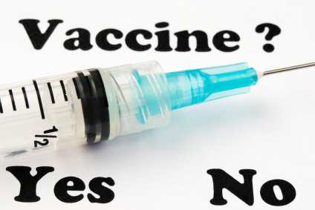
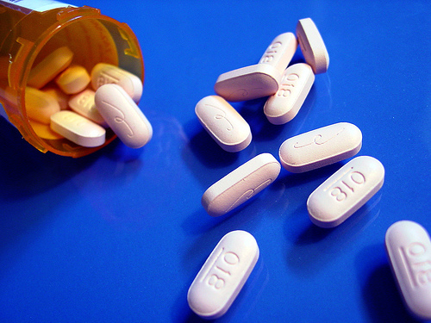
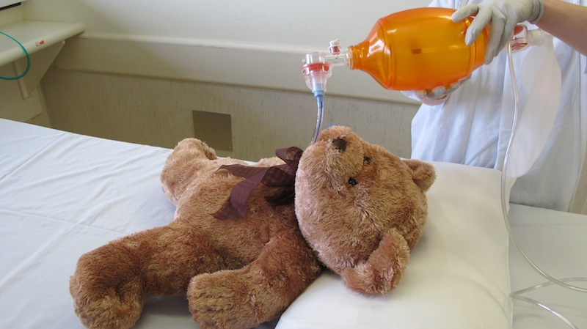
Ebola: Vaccine/cure
Rehydration and treatment of specific symptoms, improves survival. There has been no official cure for EVD. Potential treatments are undergoing evaluation such as, immune therapies and drug therapies.
“No licensed vaccines are available yet, but 2 potential vaccines are undergoing human safety testing.”-WHO

Slide 9
Ebola: 2014 west Africa outbreak
“The 2014 Ebola epidemic is the largest in history, affecting multiple countries in West Africa. “- CDC
(Updated November 7,2014) – CDC.gov

Slide 10
Ebola: 2014 west Africa outbreak
Countries with cases of Ebola
Countries with widespread transmission: Guinea, Liberia, Sierra Leone
Countries without widespread transmission: Mali (Kayes), Spain (Madrid), United States (Dallas, TX, New York City)
Countries with no current transmission: Nigeria and Senegal
http://www.cdc.gov/vhf/ebola/outbreaks/2014-west-africa/distribution-map.html

Slide 11
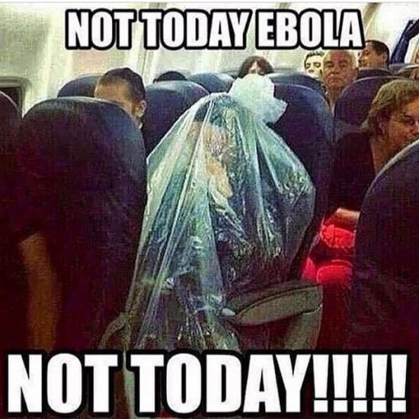
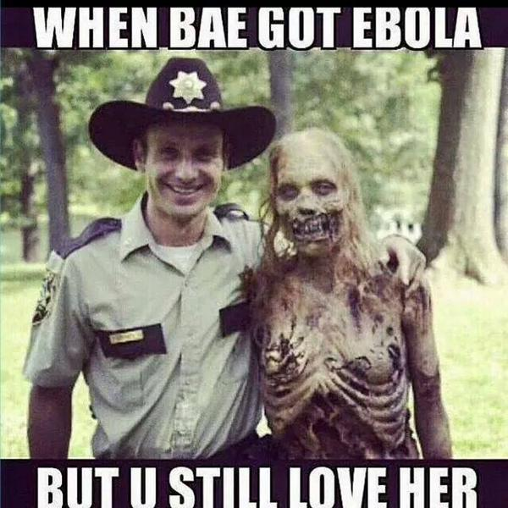
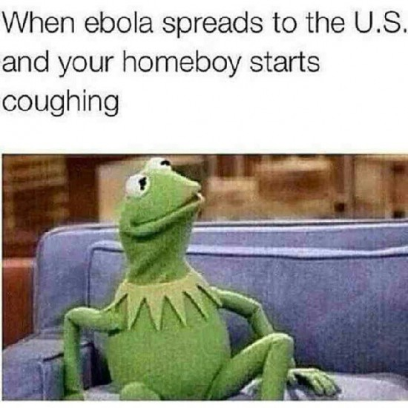
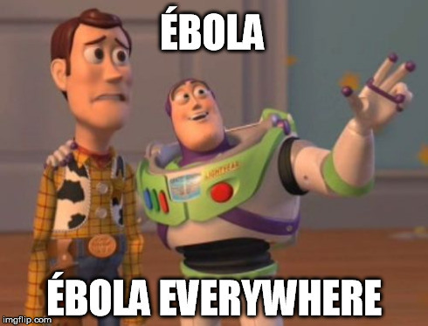
Ebola: fear
We are not affected (Infection-wise) by Ebola unless we have come in contact with an infected person.
The fear is not real, it is an over reaction.
Only 4 Americans have been infected with Ebola, including 1 death and 1 survivor.
Video: https://www.youtube.com/watch?v=lAz-F1QnyCk

Slide 12
Ebola: American outbreak
“President Barack Obama hugs nurse Nina Pham, who was declared free of the Ebola virus after contracting the disease while caring for a Liberian patient in Texas, during a meeting in the Oval Office in Washington on Oct. 24, 2014”
http://time.com/3537430/obama-hugs-nurse-ebola-survivor/
NYC Doctor Is well enough to be playing the Banjo and exercising. Discharge soon. http://time.com/3571401/nyc-doctor-ebola-banjo-craig-spencer/
Thomas Eric Duncan was the first person to be diagnosed with Ebola in the U.S. He passed away on Wednesday, October 8th, 2014. http://time.com/3481824/ebola-patient-thomas-eric-duncan-dies/
“Amber Vinson a Texas nurse who contracted Ebola after treating an infected patient stands with her nursing team during a press conference after being released from care at Emory University Hospital on Aug. 1, 2014 in Atlanta.”
http://time.com/3566147/ebola-survivor-amber-vinson-opens-up/

Slide 13
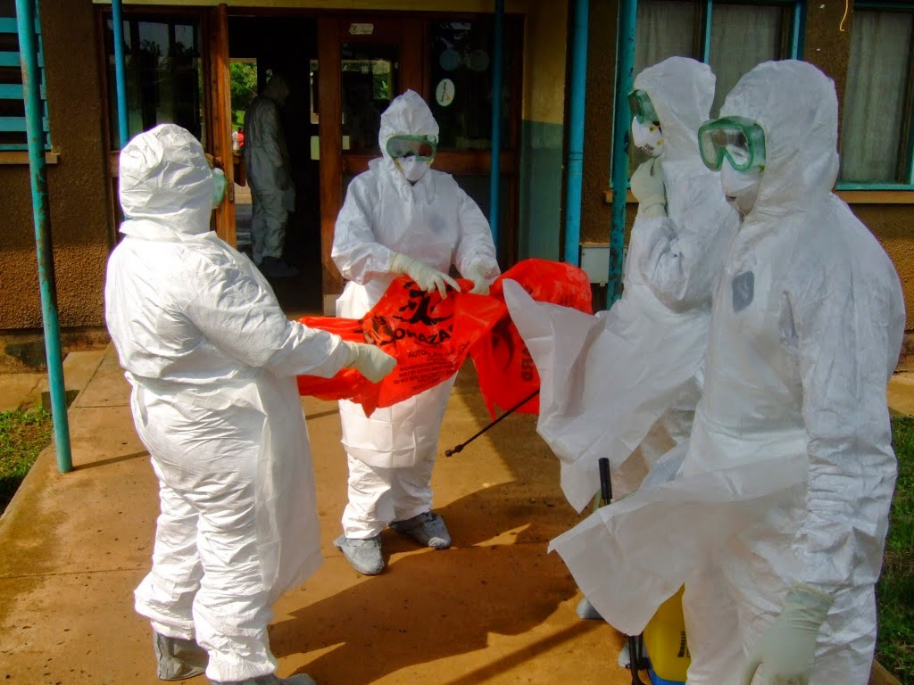
Ebola: Prevention
“The recent filovirus outbreaks in Africa underscore the need for improved disease surveillance and early warning systems, which become increasingly important for diseases of relatively low occurrence, but with a major public health impact at the international level”
“The lack of adequate laboratory facilities and integrated disease surveillance systems, especially in regions where filoviruses are endemic, will largely prevent these regions from being monitored for disease trends and initiate the required actions.” http://www.ncbi.nlm.nih.gov/pmc/articles/PMC3378103/

Slide 14
Ebola: conclusion
How bad of a threat is it for us?
As long as proper isolation methods are used we should be safe.
Ebola is not a major threat for us!
…But it is for the citizens of West Africa

Slide 15
Works cited
"2014 Ebola Outbreak in West Africa." Centers for Disease Control and Prevention. Centers for Disease Control and Prevention, 08 Oct. 2014. Web. 11 Oct. 2014. <http://www.cdc.gov/vhf/Ebola/outbreaks/2014-west-africa/index.html>.
"Ebola Virus Disease." WHO. N.p., n.d. Web. 11 Oct. 2014. <http://www.who.int/mediacentre/factsheets/fs103/en/>.
Martina, Byron EE, and Albert DME Osterhaus. "Ebola." National Center for Biotechnology Information. U.S. National Library of Medicine, 28 Sept. 0005. Web. 05 Nov. 2014. <http://www.ncbi.nlm.nih.gov/pmc/articles/PMC3378103/>.
Taylor, Derek J., Robert W. Leach, and Jeremy Bruenn. "Filoviruses Are Ancient and Integrated into Mammalian Genomes." Filoviruses Are Ancient and Integrated into Mammalian Genomes (2010): n. pag. BMC Evolutionary Biology. 22 June 2010. Web. 05 Nov. 2014. <http://www.biomedcentral.com/1471-2148/10/193>.
Time.com: http://time.com/3571401/nyc-doctor-ebola-banjo-craig-spencer/
http://time.com/3481824/ebola-patient-thomas-eric-duncan-dies/
http://time.com/3566147/ebola-survivor-amber-vinson-opens-up/
http://time.com/3537430/obama-hugs-nurse-ebola-survivor/

